Slide 1
Responding to Federal agents
At the end of this training, you will be able to:
Describe what to do if a Federal Agent (eg. ICE or FBI) arrives at your building and demands access.
Identify when you need to ask a supervisor or designated person for help.

Slide 2
Know WHAT to DO BEFORE AN AGENT ARRIVES
The City agency or shelter that you work for is required to:
Have a protocol in place to respond if an ICE or non-local agent requests access to your building.
Designate a staff person who is qualified to evaluate any warrants presented to make sure they are valid.
Share the protocol and the name and contact information of the designated person with you.

Slide 3
Know WHAT to DO BEFORE AN AGENT ARRIVES
Let’s look at the general protocol for a city agency or shelter.
The protocol may vary at your specific location. You must follow the protocol at your site.

Slide 4
Procedure for interactions with non-local law enforcement
Security Officer: “Can I see your ID?”
No valid ID presented.
Security Officer: “I’m not authorized to let you in without ID.”
If they enter anyway, call NYPD.
Federal Officer provides valid ID.
Security Officer: “What is the purpose of your visit?”
Federal Officer: “I am looking for an individual.”
Security Officer: “Do you have a judicial warrant?”
No judicial warrant presented.
Security Officer: “I’m not authorized to let you in.”
Federal Officer: "Yes".
Security Officer: "I am not authorized to review warrants. I will contact our Designated Person to review the warrant." Please wait
Take a picture of warrant get it to Designated person. Designated Person reviews validity. If valid, let them in.
Notes:
Last 2 bubble should add that SO needs to ask Fed agent to wait; and that SO needs to send warrant to designated person and wait to hear back from designated person before acting.

Slide 5
reminders
Never engage with physical or verbal altercation with a law enforcement officer
Always call your supervisor/designated person
Take a photo of any warrant and officer ID, if possible
Make sure you write a detailed report

Slide 6
Procedure for interactions with non-local law enforcement
We will now discuss the 3 scenarios with interactions with ICE or other non-local law enforcement.
Think about what you think a security officer should do in each scenario based on the procedures from the previous slides.

Slide 7
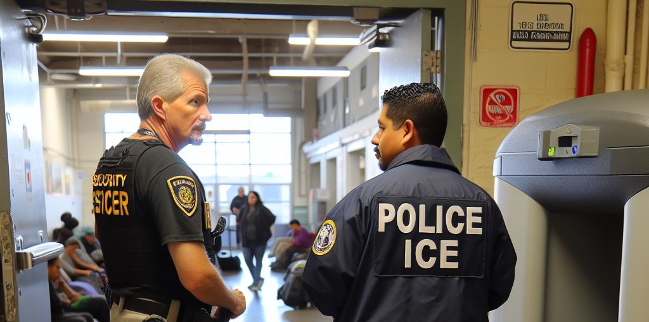
Scenario # 1
An ICE officer comes into the building and encounters the security officer on duty. The security officer asks for a valid ID, but the ICE officer doesn’t have one.
What should the security officer do?

Slide 8
Scenario # 1
I am with ICE. I don’t have an ID.
I’m not authorized to let you in without ID.
Notes:
If they enter anyway, call the NYPD.

Slide 9
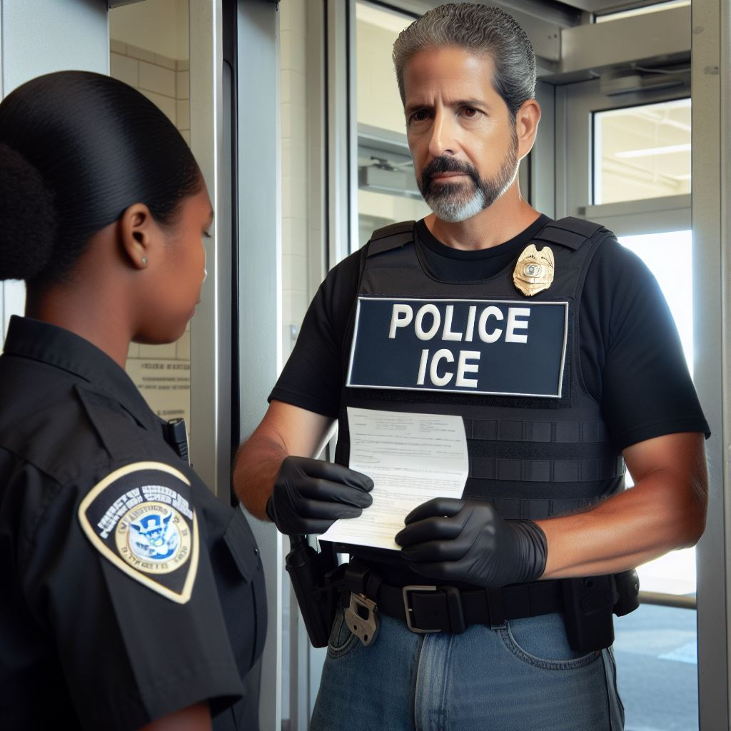
Scenario # 2
An ICE officer comes to your building and encounters the security officer on duty. The ICE officer shows a valid ID and asks to find a specific individual. The security officer asks for a warrant and the ICE officer does not have a warrant.
What should the security officer do?

Slide 10
Scenario # 2
I am looking for an individual. I do not have a warrant.
I’m not authorized to let you in without a warrant.

Slide 11
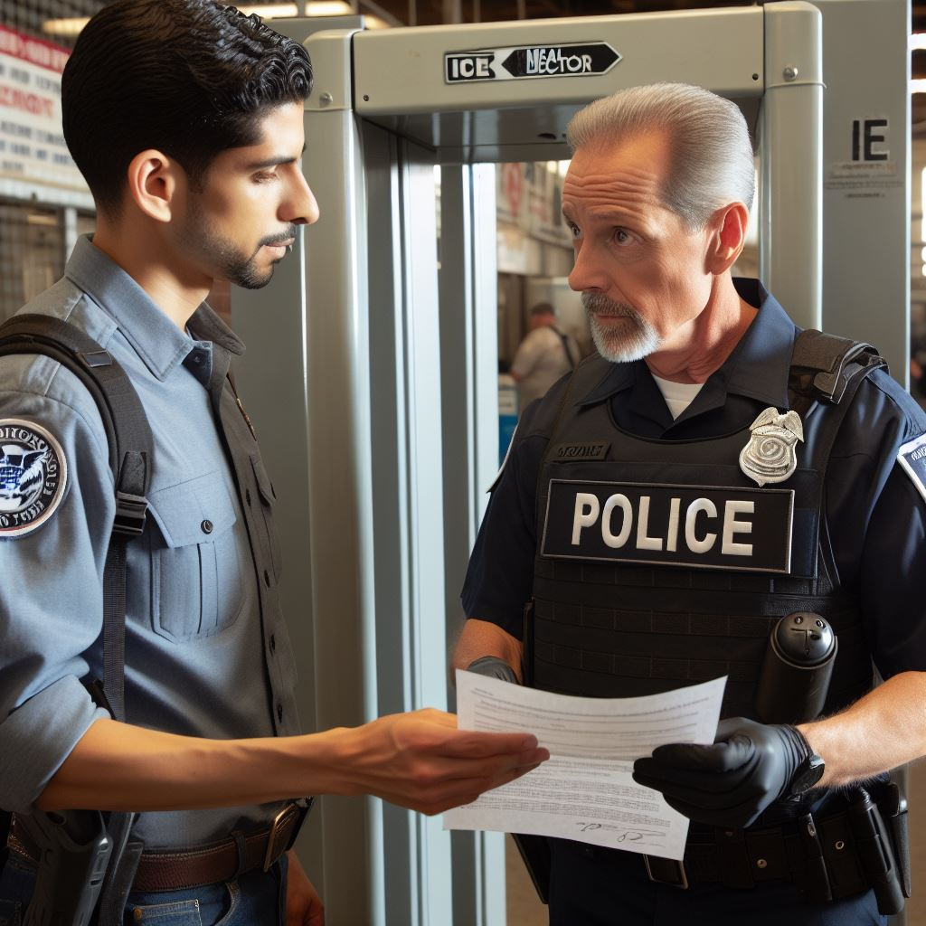
Scenario # 3
ICE officer comes into the building and encounters the security officer on duty. The ICE officer shows a valid ID and asks to find a specific individual. The security officer asks for a warrant and the ICE officer shows them a warrant.
What should the security officer do?

Slide 12
Scenario # 3
I am looking for an individual. Here is my official warrant.
I’m not authorized to review warrants. I will call my supervisor/designated person and arrange for them to review warrant. Please waint. you can speak to them.

Slide 13
Procedure for interactions with non-local law enforcement
Let’s review: What should a security officer do in these 3 situations:
Non-local law enforcement shows up to the building and has:
NO ID
NO warrant
A warrant
Share your ideas with a partner

Slide 14

Federal agents
Plan ahead and make sure to talk to your supervisor to prepare for when federal agents show up to the shelter.
Know the protocol for your building.
Know who is the designated person to review warrants and have their contact info.
DRAFT

